Slide 1
Secure Hash Algorithm

Slide 2
SECURE HASH ALGORITHM
Published by National Institute of Standards and technology (NIST) in the year of 1993.
It is used to data integrity and authentication.
The various version of SHA are
Here we are going to see about SHA 512
Algorithm | Block Size (bits) | Message Digest Size (bits)
SHA 1 | 512 | 160
SHA 256 | 512 | 256
SHA 512 | 1024 | 512

Slide 3
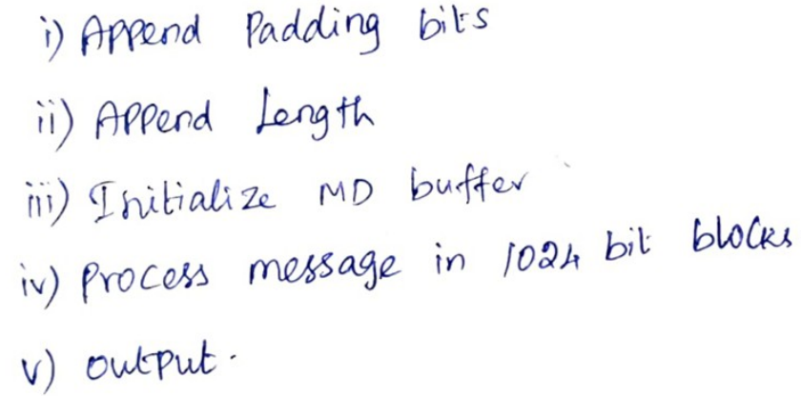
IMPORTANT KEY POINTS AND STEPS
Plain text is processed in terms of blocks
Input - 1024 bits size of Blocks
Output - 512 bits size of Message Digest
Processing of messages – 1024 bits
Steps involve in SHA 512 are

Slide 4
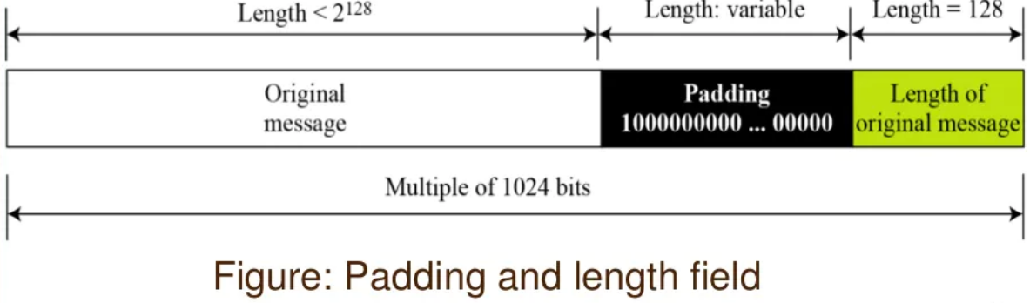
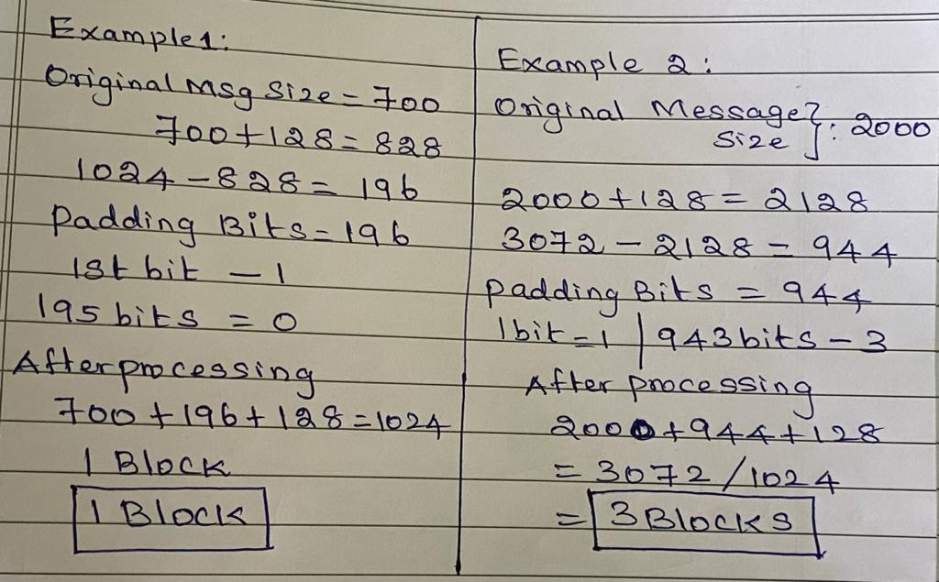
Step1 and Step 2

Slide 5
Append padding bits
The message is padded so that its length is congruent to 896 modulo 1024 [length≡ 896(mod 1024)].
Padding is always added, even if the message is already of the desired length. Thus, the number of padding bits is in the range of 1 to 1024.
The padding consists of a single 1 bit followed by the necessary number of 0 bits.
For Ex,
length≡ 896(mod 1024)
700 ≡ 896(mod 1024)
700 + 196 ≡ 896(mod 1024)

Slide 6
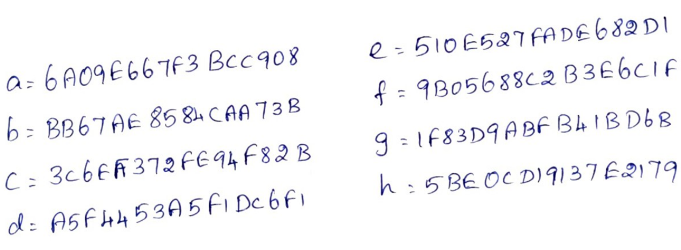
Step 3: Initialize MD Buffer
MD buffer value (8 Buffer * 64 = 512 bits)
  Store the intermediate Message Digest
  Store the final Message Digest
When 1st Block processing – MD Buffers – Initialized with the following Hexadecimal
When 2nd Block processing – Output Hash code from Block 1 Processing

Slide 7
Step 4: Processing of messages – 1024 bits
Input block is processed – 80 rounds
512 bits MD buffer value (8 * 64 = 512 bits)
Qword - (W_{t} – W₀ to W₇₉) - 64 bits - Derived from 1024 bits block
  These words represent the first 64 bits of the fractional parts of the cube roots of the first 80 prime numbers.
Additive Constant (K_{t} – K₀ to K₇₉) - 64 bits - 80 constants.
After all N 1024-bit blocks have been processed, the output from the Nth stage is the 512-bit message digest.

Slide 8
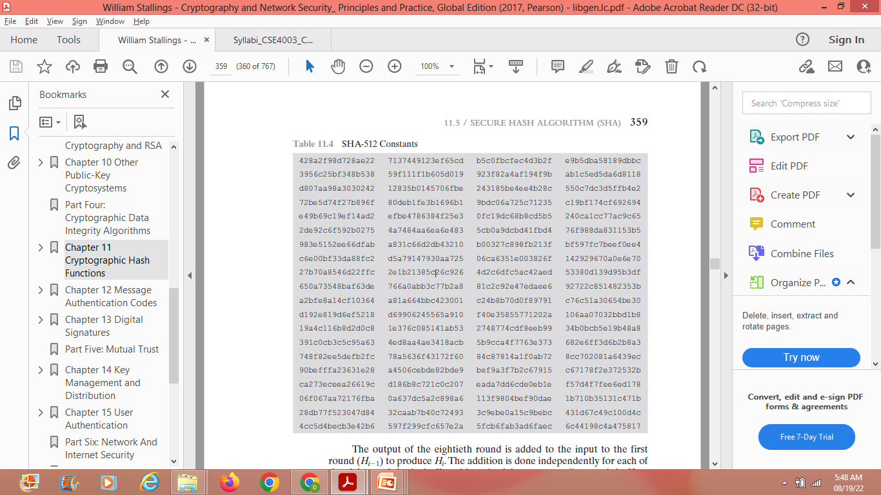
SHA 512 Constants

Slide 9
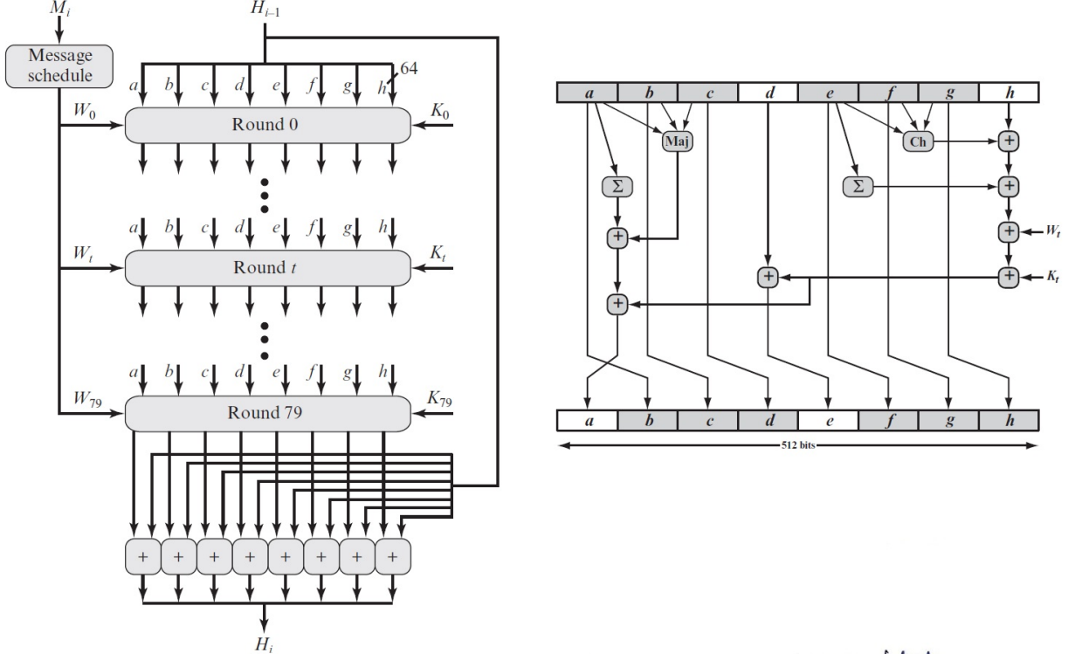
Cont step 4: Processing of messages – 1024 bits

Slide 10
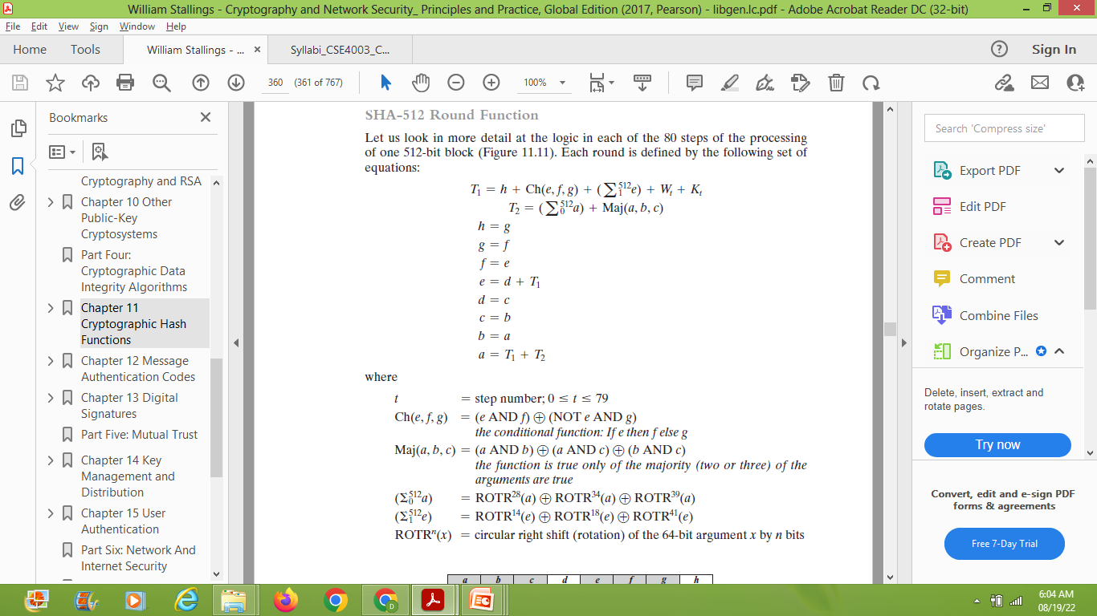
SHA-512 Round Function

Slide 11
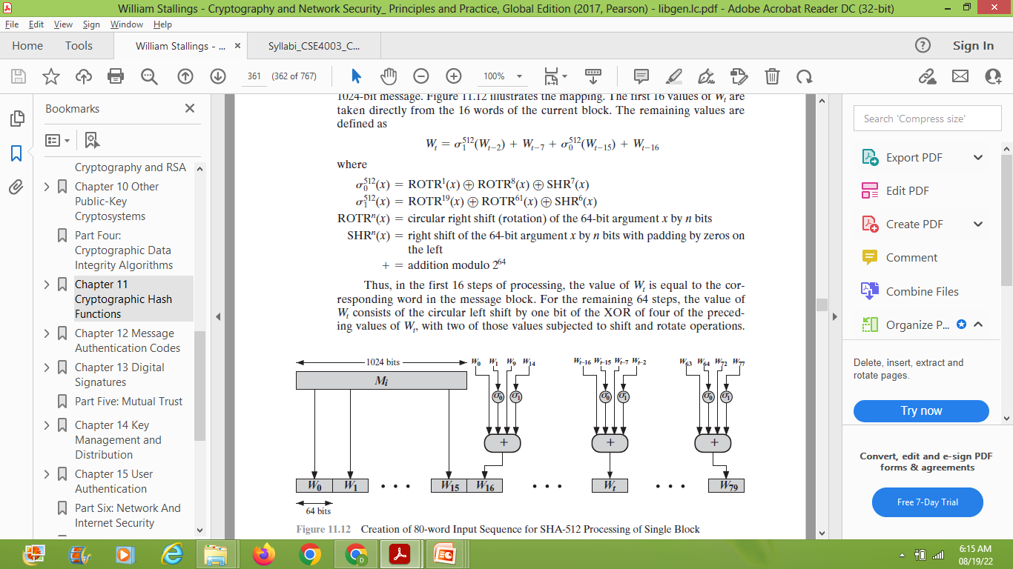
Creation of 80-word Input Sequence for SHA-512 Processing of Single Block

Slide 12
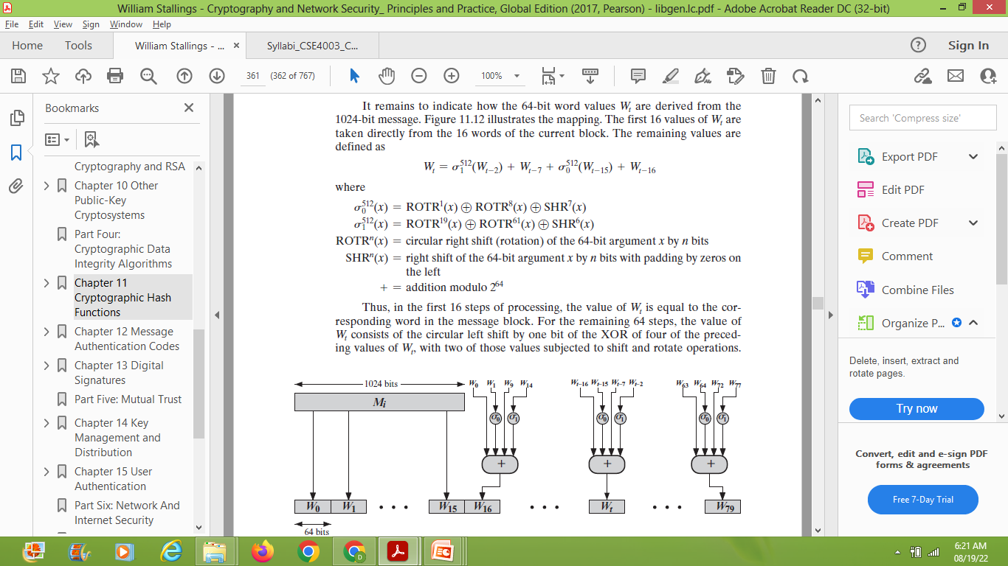

Slide 13
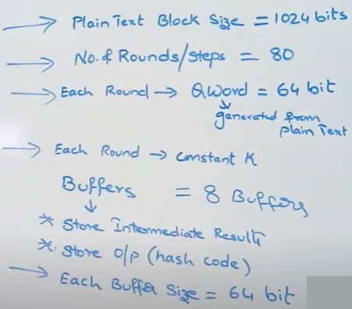

Slide 14
Step 5: Output
After all N 1024-bit blocks have been processed, the output from the Nth stage is the 512-bit message digest.

